Slide 1
Cleaning Window
Final Project Presentation
Liusu Zeng, Wenquan Xin, Ang Li, Junhao Li

Slide 2
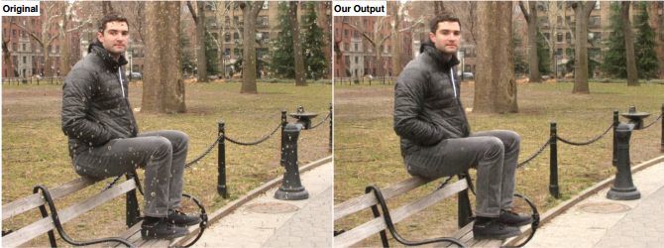
Problem Background
Raindrops reduce photo quality
Our goals: Eliminate raindrop effects

Slide 3
Initial Attempts
Experimented with basic transforms:
Median filter
Low-pass filter
Edge detection

Slide 4
Our Method
Three steps:
Rain detection—— Hough Transform
Structure and Texture isolation——PDE(Total variation)
Restoration——Patch Matching

Slide 5



Our Method
Hough Transform (Circles)
Using parameter equation to present circle
Voting, majority rule
Detection
$$\left(ρcosθ+x_{0},ρsinθ+y_{0}\right)$$
$$θ$$
$$ρ$$
$$θ$$

Slide 6
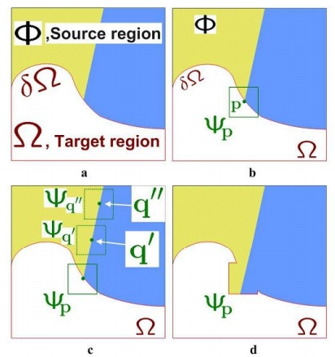
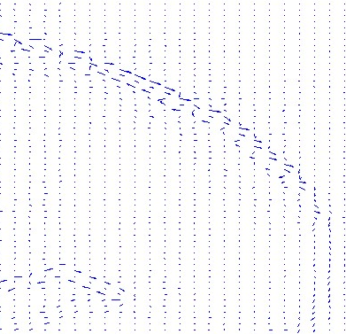
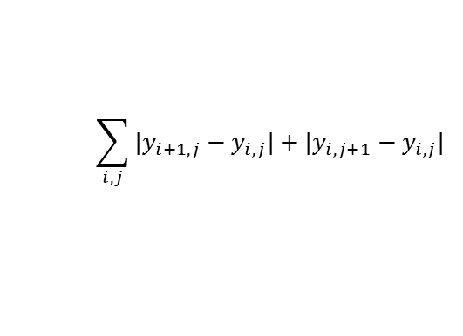
Our Method
PDE isolation (TV)
decompose image into a structural image and a texture image
anisotropic total variance:
$$\sum_{i,j}{|y_{i+1,j}−y_{i,j}|+|y_{i,j+1}−y_{i,j}|}$$

Slide 7
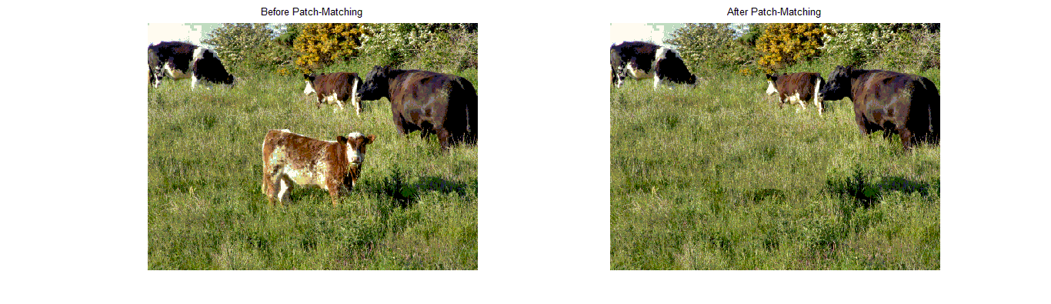
Our Method
Patch Matching
Compare region with its neighbor patch
Replace the region with the most similar patch

Slide 8
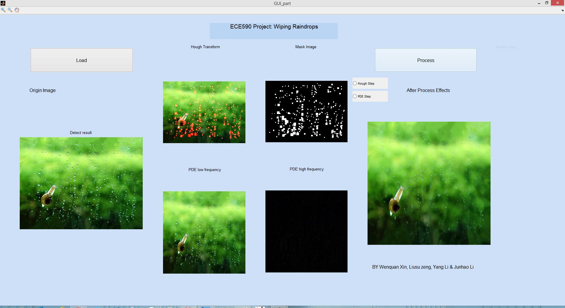
Results

Slide 9
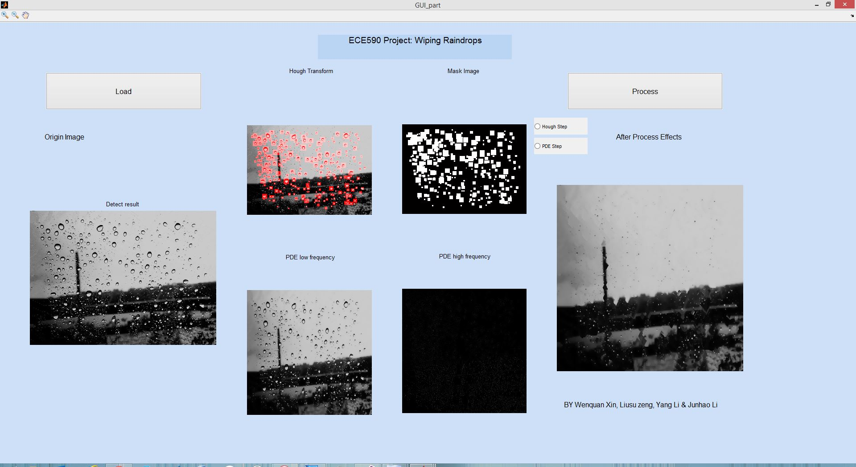
Results

Slide 10
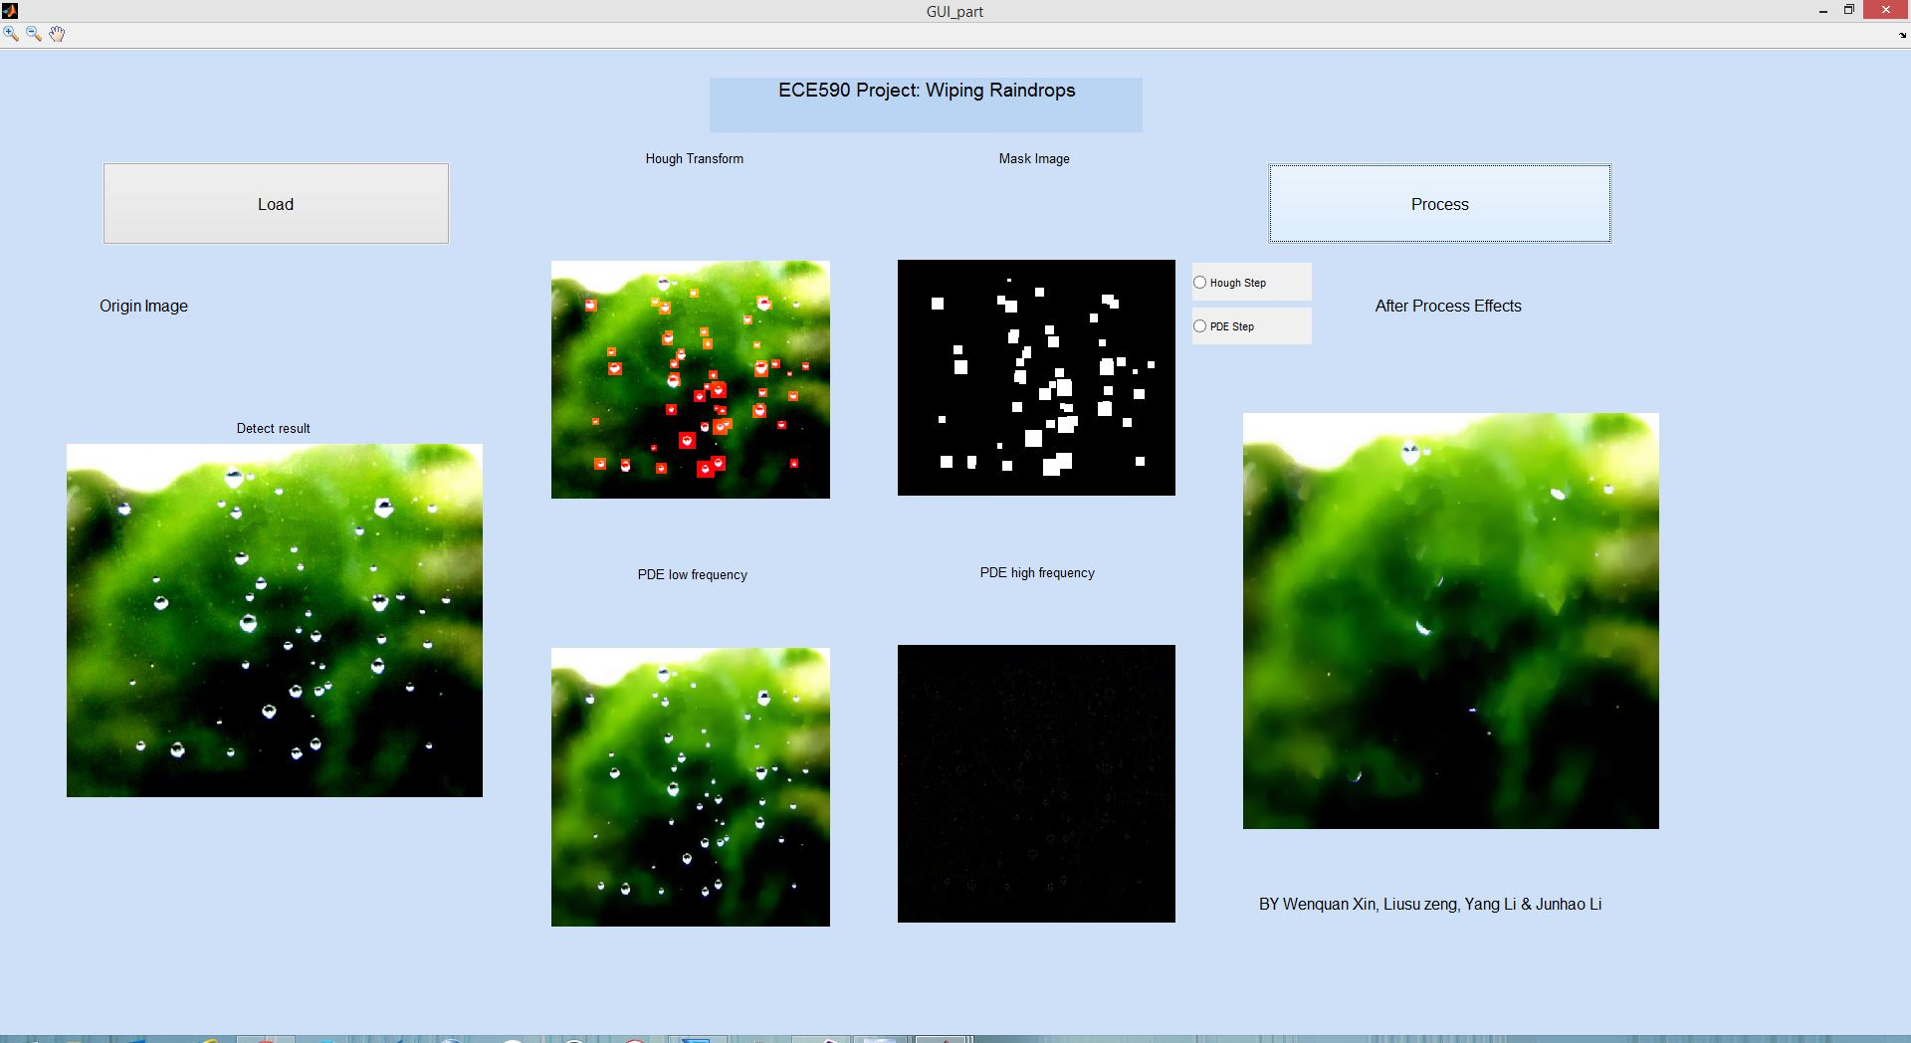
Results

Slide 11
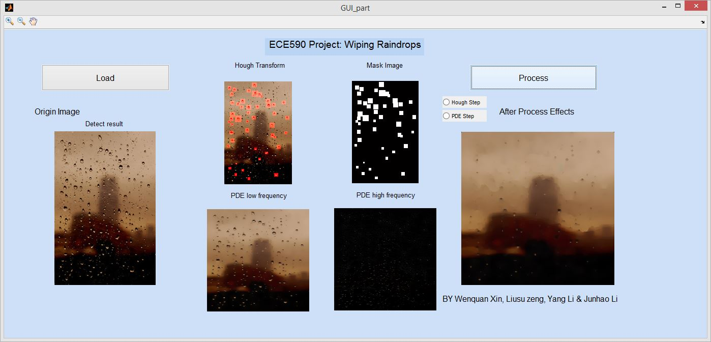
Results

Slide 12
Possible Extensions
Try to eliminate large rain drops
Improve patch matching method

Slide 13
Thank you.
See you in the next semester, thank you…

